Slide 1
P-N Junction

Slide 2
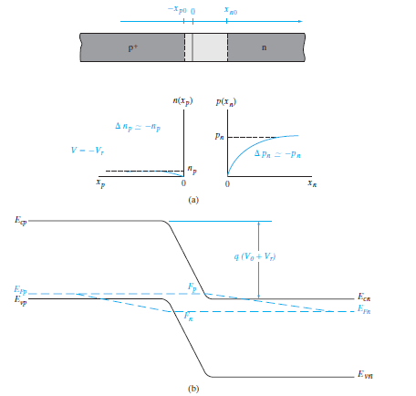
Reverse Bias

Slide 3
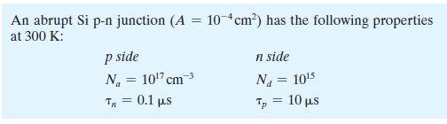


Slide 4
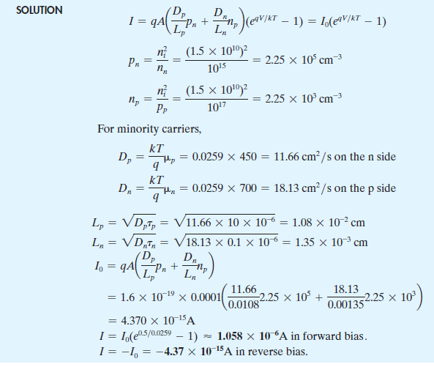

Slide 5
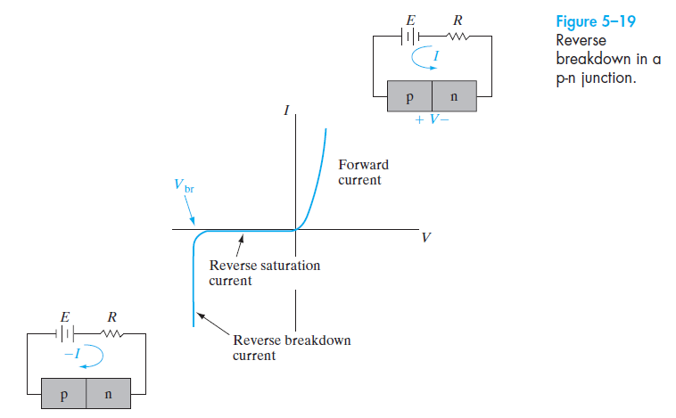
Reverse-Bias Breakdown

Slide 6
Reverse breakdown can occur by two mechanisms:
1. Zener effect (Zener breakdown): breakdown occurs at lower voltages (up to a few volts reverse bias).
2. Avalanche breakdown: breakdown occurs at higher voltages (from a few volts to thousands of volts)

Slide 7
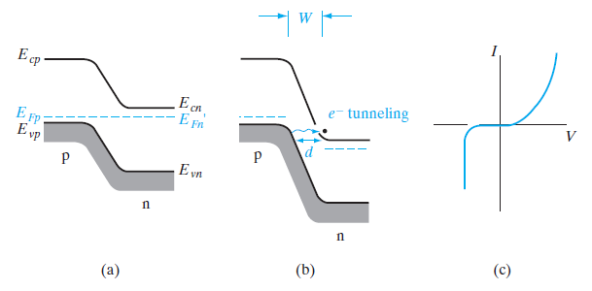
Zener Breakdown
Fig: The Zener effect: (a) heavily doped junction at equilibrium; (b) reverse bias with electron tunneling from p to n; (c) I–V characteristic.

Slide 8
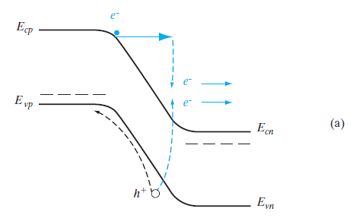
Avalanche Breakdown
(a) band diagram of a p-n junction in reverse bias showing a (primary) electron gaining kinetic energy in the field of the depletion region, and creating a (secondary) electron–hole pair by impact ionization, the primary electron losing most of its kinetic energy in the process;

Slide 9
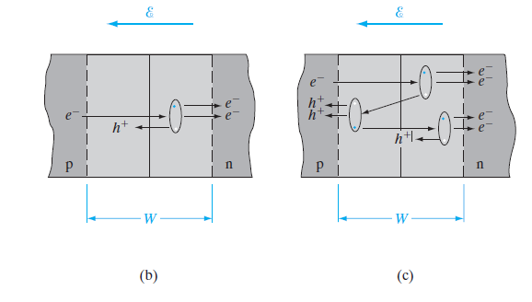
(b) a single ionizing collision by an incoming electron in the depletion region of the junction;
(c) primary, secondary, and tertiary collisions.

Slide 10



Total number of electrons out of the region at n after many collisions, we have,
Electron multiplication Mn is given by,
Measurements of carrier multiplication M in junctions near breakdown lead to,
The exponent n varies from about 3 to 6, depending on the type of material used for the junction.

Slide 11
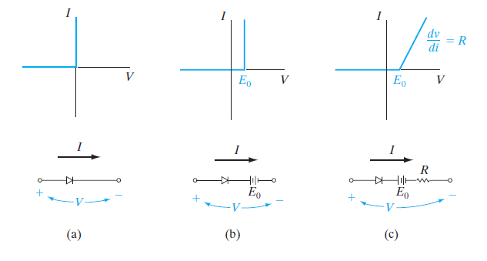
Rectifiers
Fig.1: Piecewise-linear approximations of junction diode characteristics:(a) the ideal diode; (b) ideal diode with an offset voltage; (c) ideal diode
with an offset voltage and a resistance to account for slope in the forward characteristic.

Slide 12
Requirements of Junction diodes used as rectifiers:
I–V characteristics should as close as possible to that of the ideal diode
The reverse current should be negligible
the forward current should exhibit little voltage dependence (negligible forward resistance R)
The reverse breakdown voltage should be large
The offset voltage E0 in the forward direction should be small.

Slide 13
Various requirements for good rectifier junctions:
Band gap: for choosing a material for rectifier diodes.
Since ni is small for large band gap materials where the reverse saturation current (which depends on thermally generated carriers) decreases with increasing Eg.
A rectifier made with a wide band gap material can be operated at higher temperatures.
Si is generally preferred over Ge for power rectifiers because of its wider band gap, lower leakage current, and higher breakdown voltage, as well as its more convenient fabrication properties.

Slide 14
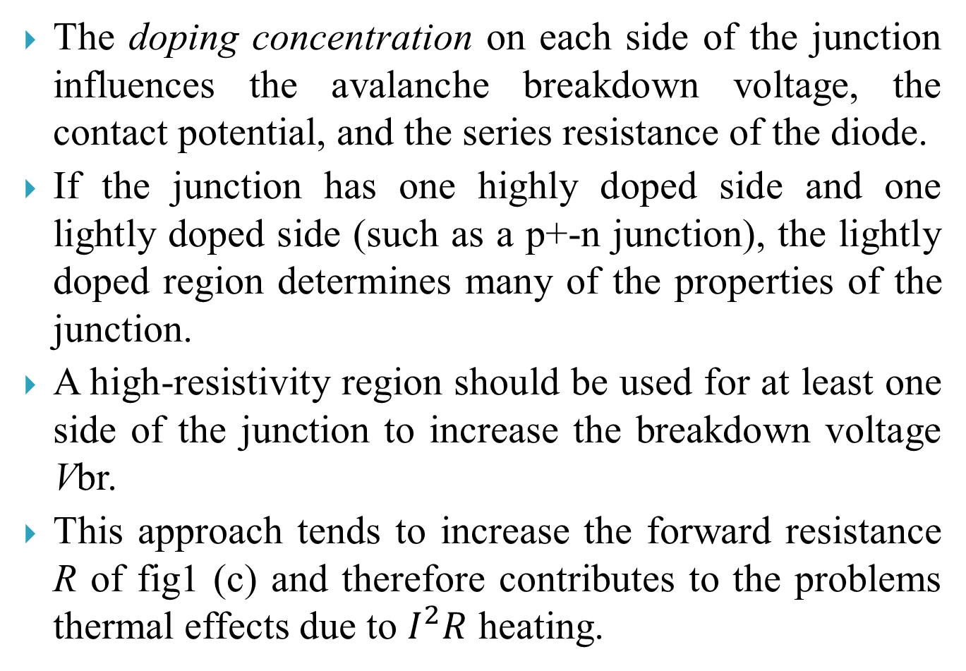
The doping concentration on each side of the junction influences the avalanche breakdown voltage, the contact potential, and the series resistance of the diode.
If the junction has one highly doped side and one lightly doped side (such as a p+-n junction), the lightly doped region determines many of the properties of the junction.
A high-resistivity region should be used for at least one side of the junction to increase the breakdown voltage Vbr.
This approach tends to increase the forward resistance R of fig1 (c) and therefore contributes to the problems thermal effects due to $I^{2}R$ heating.

Slide 15
The physical geometry of the diode is another important design variable to reduce the resistance of the lightly doped region, it is necessary to make its area large and reduce its length.
Defect in junction uniformity can cause premature reverse breakdown in a small region of the device.
One of the primary problems with a short, lightly doped region is an effect called punch-through.
The result of punch-through is a breakdown below the value of Vbr

Slide 16
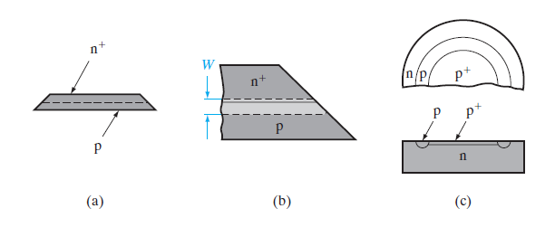
Fig 2: Beveled edge and guard ring to prevent edge breakdown under reverse bias: (a) diode with beveled edge; (b) closeup view of edge, showing reduction of depletion region near the level; (c) guard ring.

Slide 17
Premature breakdown across the edge of the sample can be reduced by beveling the edge or by diffusing a guard ring to isolate the junction from the edge of the sample.
The electric field is lower at the beveled edge of the sample in Fig2.b than it is in the main body of the device.
Similarly, the junction at the lightly doped p guard ring of Fig2.c breaks down at higher voltage than the p+-n junction.
Since the depletion region is wider in the p ring than in the p+ region, the average electric field is smaller at the ring for a given diode reverse voltage.

Slide 18
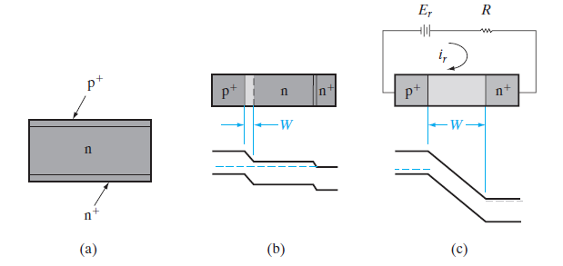
Fig.3 : A p+-n-n+ junction diode: (a) device configuration; (b) zero-bias condition; (c) reverse-biased to punch-through.

Slide 19
The lightly doped center region determines the avalanche breakdown voltage.
If this region is short compared with the minority carrier diffusion length, the excess carrier injection for large forward currents can increase the conductivity of the region.
This type of conductivity modulation, which reduces the forward resistance R, can be very useful for high-current devices.
A short, lightly doped center region can also lead to punch-through under reverse bias.

Slide 20
Optoelectronic Devices

Slide 21
Photodiodes
Junction devices can be used to improve the speed of response and the sensitivity of detectors of optical or high-energy radiation.
Two-terminal devices designed to respond to photon absorption are called photodiodes.
Photodiodes have extremely high sensitivity and response speed.

Slide 22
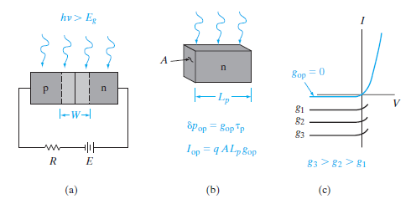
Current and Voltage in an Illuminated Junction
Fig: Optical generation of carriers in a p-n junction: (a) absorption of light by the device; (b) current Iop resulting from EHP generation within a diffusion length of the junction on the n side; (c) I– V characteristics of an illuminated junction.

Slide 23


The resulting current due to the collection of these optically generated carriers by the junction is

Slide 24
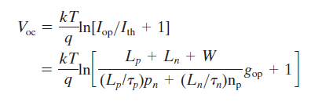

For the special case of a symmetrica junction, pn = np and tp = tn,we can rewrite Eq. in terms of the thermal generation rate pn>tn = gth and the optical generation rate gop. Neglecting generation within W:

Slide 25
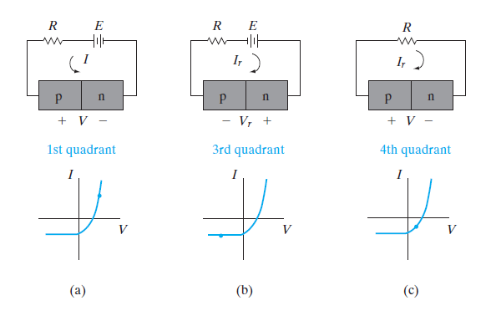
Operation o an illuminated junction in the various quadrants of its I– V characteristic; in (a) and (b), power is delivered to the device by the external circuit; in (c) the device delivers power to the load.

Slide 26
Solar Cells

